Slide 1
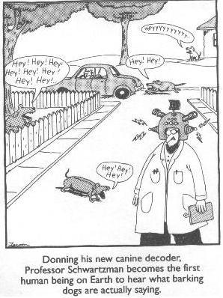
Today, November 24th
Lesson 14 PEs and Dopamine
Monday
Lesson 15 Memory/Synaptic Strength
Admin
Quiz Grades
Exam Two Rewrite:
mathewhammerstrom@uvic.ca
Final Exam
Final Grades
Missed Quizzes

Slide 2
Final Exam
Your final exam will consist of two sections.
The first section of the final exam will be the same as the Midterm exams. There will be 3 short answer questions chosen randomly from the 6 Advanced topics (10%). These questions are already available on my website.
There will also be a single application question (5%), as with the midterms you will have a choice from three possible questions. The application questions are designed to test your ability to apply what you have learned.
The second section of the final exam (worth 25%) will consist of a single essay question selected from these three questions:
1. How do we learn?
2. What do we learn?
3. How can we improve learning?
On the day of the exam I will randomly select one of the three questions and you will answer it.
The final exam is cumulative in nature – you will need to incorporate material from throughout the course to answer the application and essay questions.

Slide 3
Final Exam
On the final exam, you will also have the opportunity to redo Midterm One and Midterm Two one last time if you wish to do so.
So, TO BE CLEAR, what you will see is:
Midterm One
Midterm Two
Midterm Three (Part I of Final Exam)
Essay Question (Part II of Final Exam)

Slide 5
A Neural Basis for Reinforcement Learning

Slide 6
Thorndike’s Law of Effect
Actions that are followed by feelings of satisfaction have a greater likelihood of being generated again in the future, whereas actions that are followed by feelings of dissatisfaction have a lesser likelihood of being generated again in the future.

Slide 7
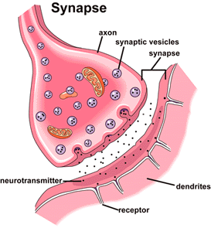
REPETITION
Increased neurotransmitter release
Increase receptors
Structural changes

Slide 8
In practice, we talk about the strength of a connection
in terms of a “weight” or a “value”.

Slide 9
What is the difference between reinforcement and supervised learning?

Slide 10
What is a prediction error?

Slide 11
What does it mean when we say a choice has "value"?

Slide 12
Learning IS ALWAYS a two step process.
At each point in time we:
1) Calculate a prediction error
2) Update the previous value

Slide 13
PE = Outcome – Expectation
New Value = Old Value + Prediction Error

Slide 14
PE = Outcome – Expectation
New Value = Old Value + (Prediction Error x Learning Rate)

Slide 15
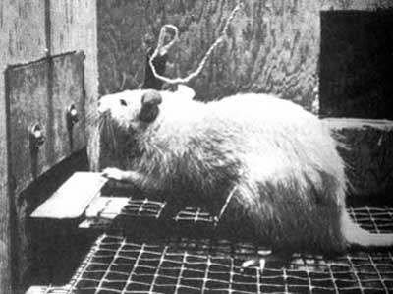
Olds & Milner, 1954

Slide 16
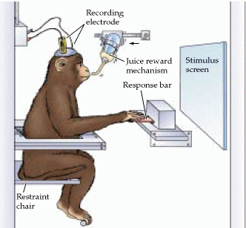

Slide 17
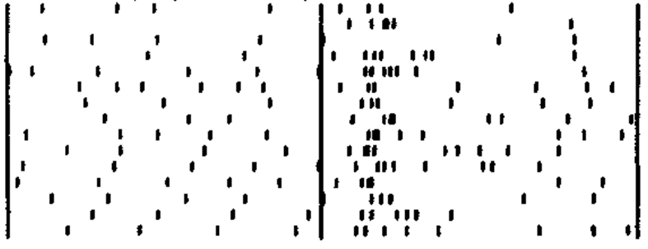
Time
Trials

Slide 18
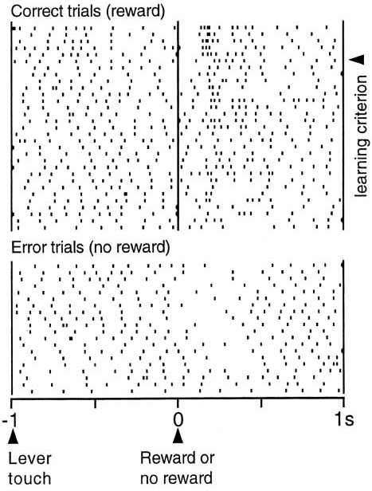

Slide 19
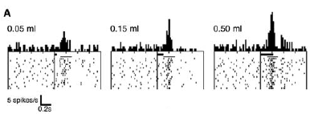

Slide 20
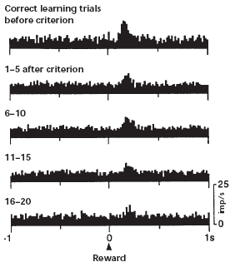

Slide 21
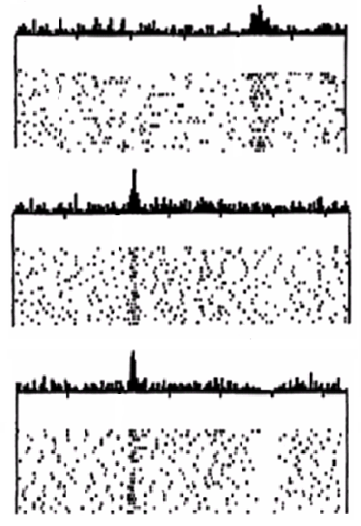

Slide 26
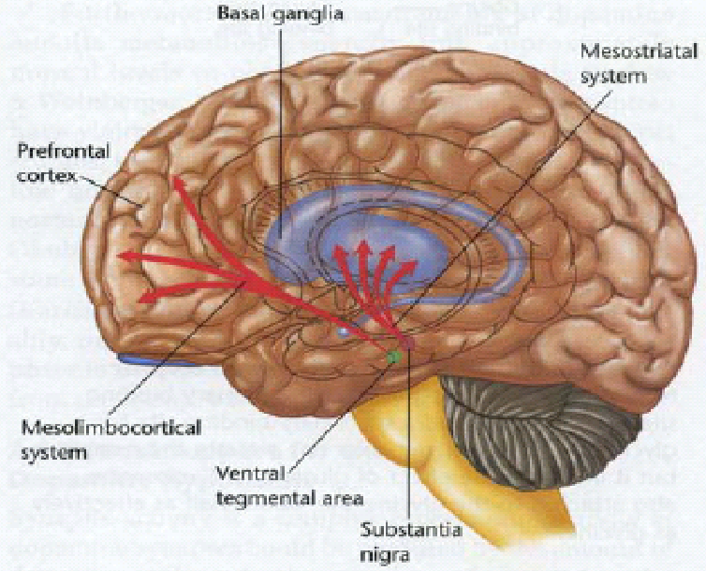

Slide 27
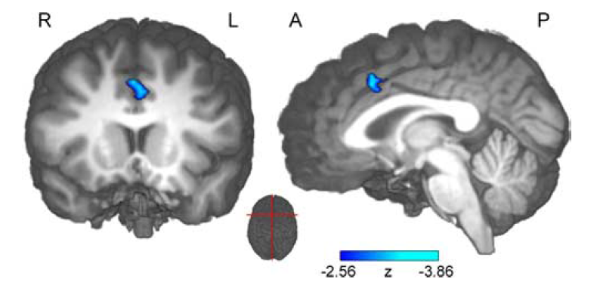
Anterior Cingulate Cortex has activity that parallels prediction errors.
But we also know that the Basal Ganglia and the Dopamine
system are involved

Slide 28
controller
(ACC)
external
input
response
output
(Holroyd & Coles, 2002)

Slide 29
EEG
controller
(ACC)
external
input
response
output
prediction
error
(dopamine)
expectation
monitor
(BG)
feedback
(Holroyd & Coles, 2002)

Slide 30


Slide 31
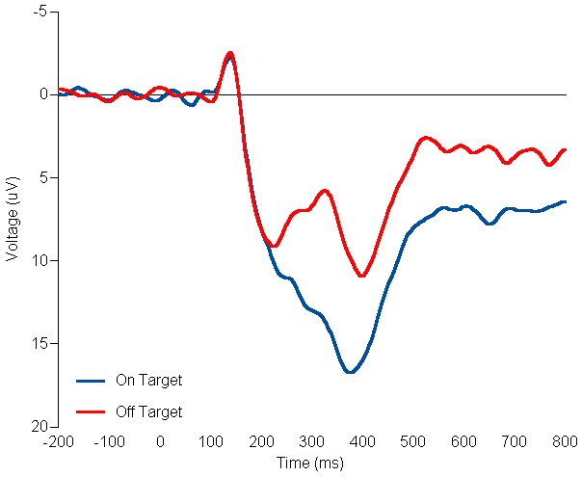
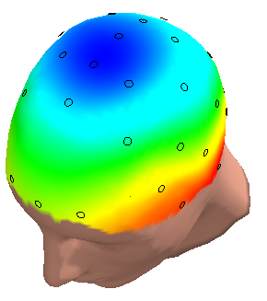
Δ Movement Amplitude
Trial n
Trial n+1

